Slide 1


Planning presentation
Fast and furious Game Playing : MonteCarlo drift
Students :
Prateek Bhatnagar Baptiste Bignon Mikaïl Demirdelen Gabriel Prevosto Dan Seeruttun--Marie Benoît Viguier
Supervisors :
Nikolaos Parlavantzas Christian Raymond
Year 2014-2015

Slide 2
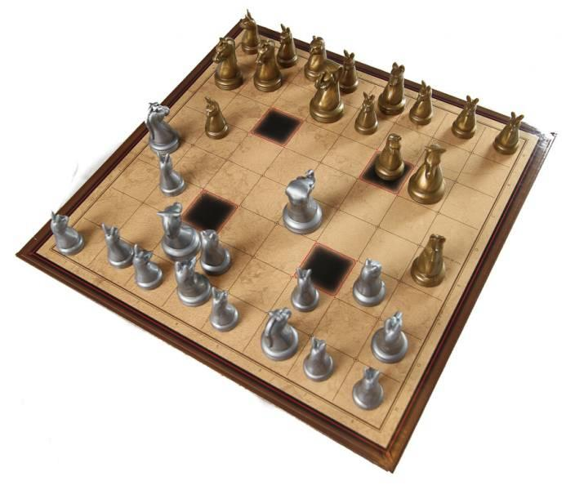
Introduction
Implementation of an artificial intelligence for Arimaa.
Use of the Monte Carlo Tree Search algorithm
Exploitation of parallelization on a set of clusters of multi-core machines
Creation of an user interface to test the algorithm against humans

Slide 3
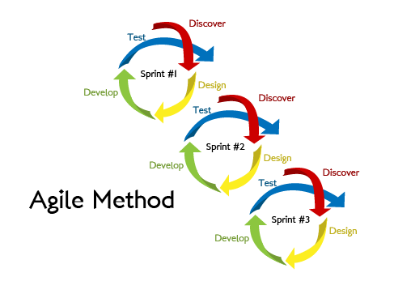
Agile Methodology:
1. Development Methodologies
Iterative software development methodology for building and testing the software incrementally.

Slide 4
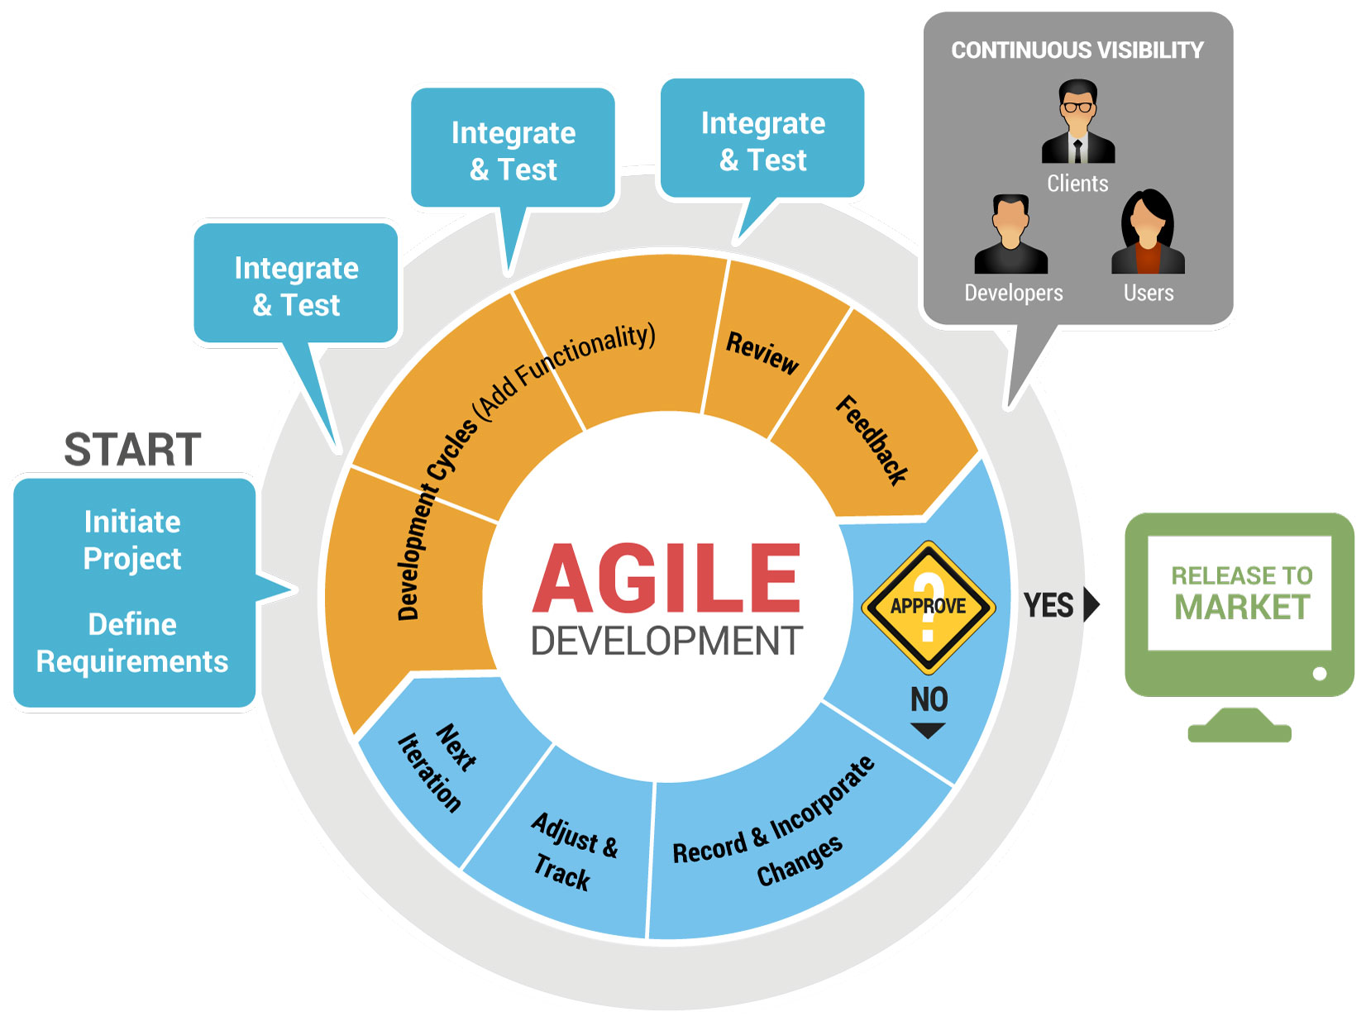
Key Areas :
1. Development Methodologies
Regular meetings
"To Do" list
Estimation of time and resources

Slide 5

Planning Poker Estimation Technique
1. Development Methodologies
Method for workloads
The method:
Guess workloads individually
No influence on the others
The treatment of solutions:
Eliminate singular guesses
Discuss together what will be the workload then
 | Gabriel | Prateek | Mikaïl | Baptiste | Benoît | Dan | Final Workload
MCTS general algorithm | 7,5 | 50 | 5 | 25 | 30 | 3 | 25

Slide 6
1. Development Methodologies
Key Areas :
Regular meetings
"To Do" list
Estimation of time and resources
Prioritization of tasks
Development using top to bottom approach
Feedback from the end user or the team
Iterations

Slide 7
2. Environment
Human resources:
Team of 6 until January
Team of 3 after January
Technological resources:
Computers from INSA's computer science department
Grid'5000, a set of clusters of multi-core machines

Slide 8
3. Risks analysis
Kinds of risk :
Resources
Organisation
Payments
Suppliers/Purchases
Technical
Unavoidable
None
None
None
Unexpected bugs can occur during the development
Interoperability problem
(Grid'5000 = linux, we currently use Windows)
Solution : dedicate enough time to fix them.
Solution : regular tests at the computer science department.

Slide 9
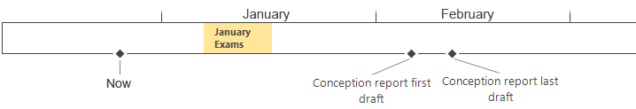
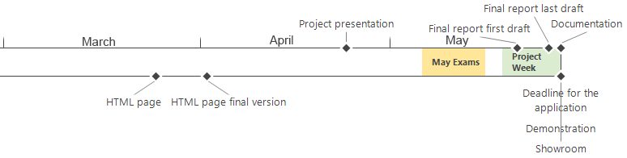
4. Important dates

Slide 10
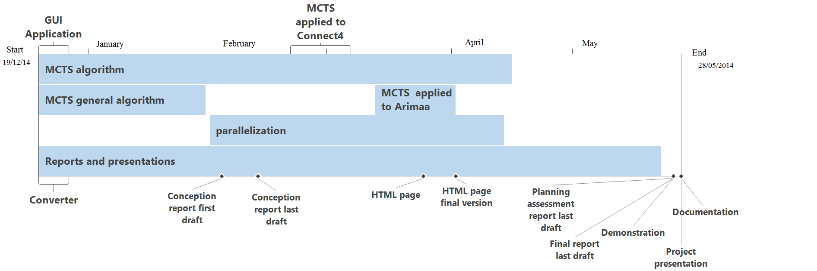
5. Tasks planning

Slide 11
Conclusion
Agile methodology along our project
Poker method to get a better estimation of the workload
Analysis of Environment
Internal and external resources
Dates
Risks
Schedule based on the aforementioned results

